Slide 1
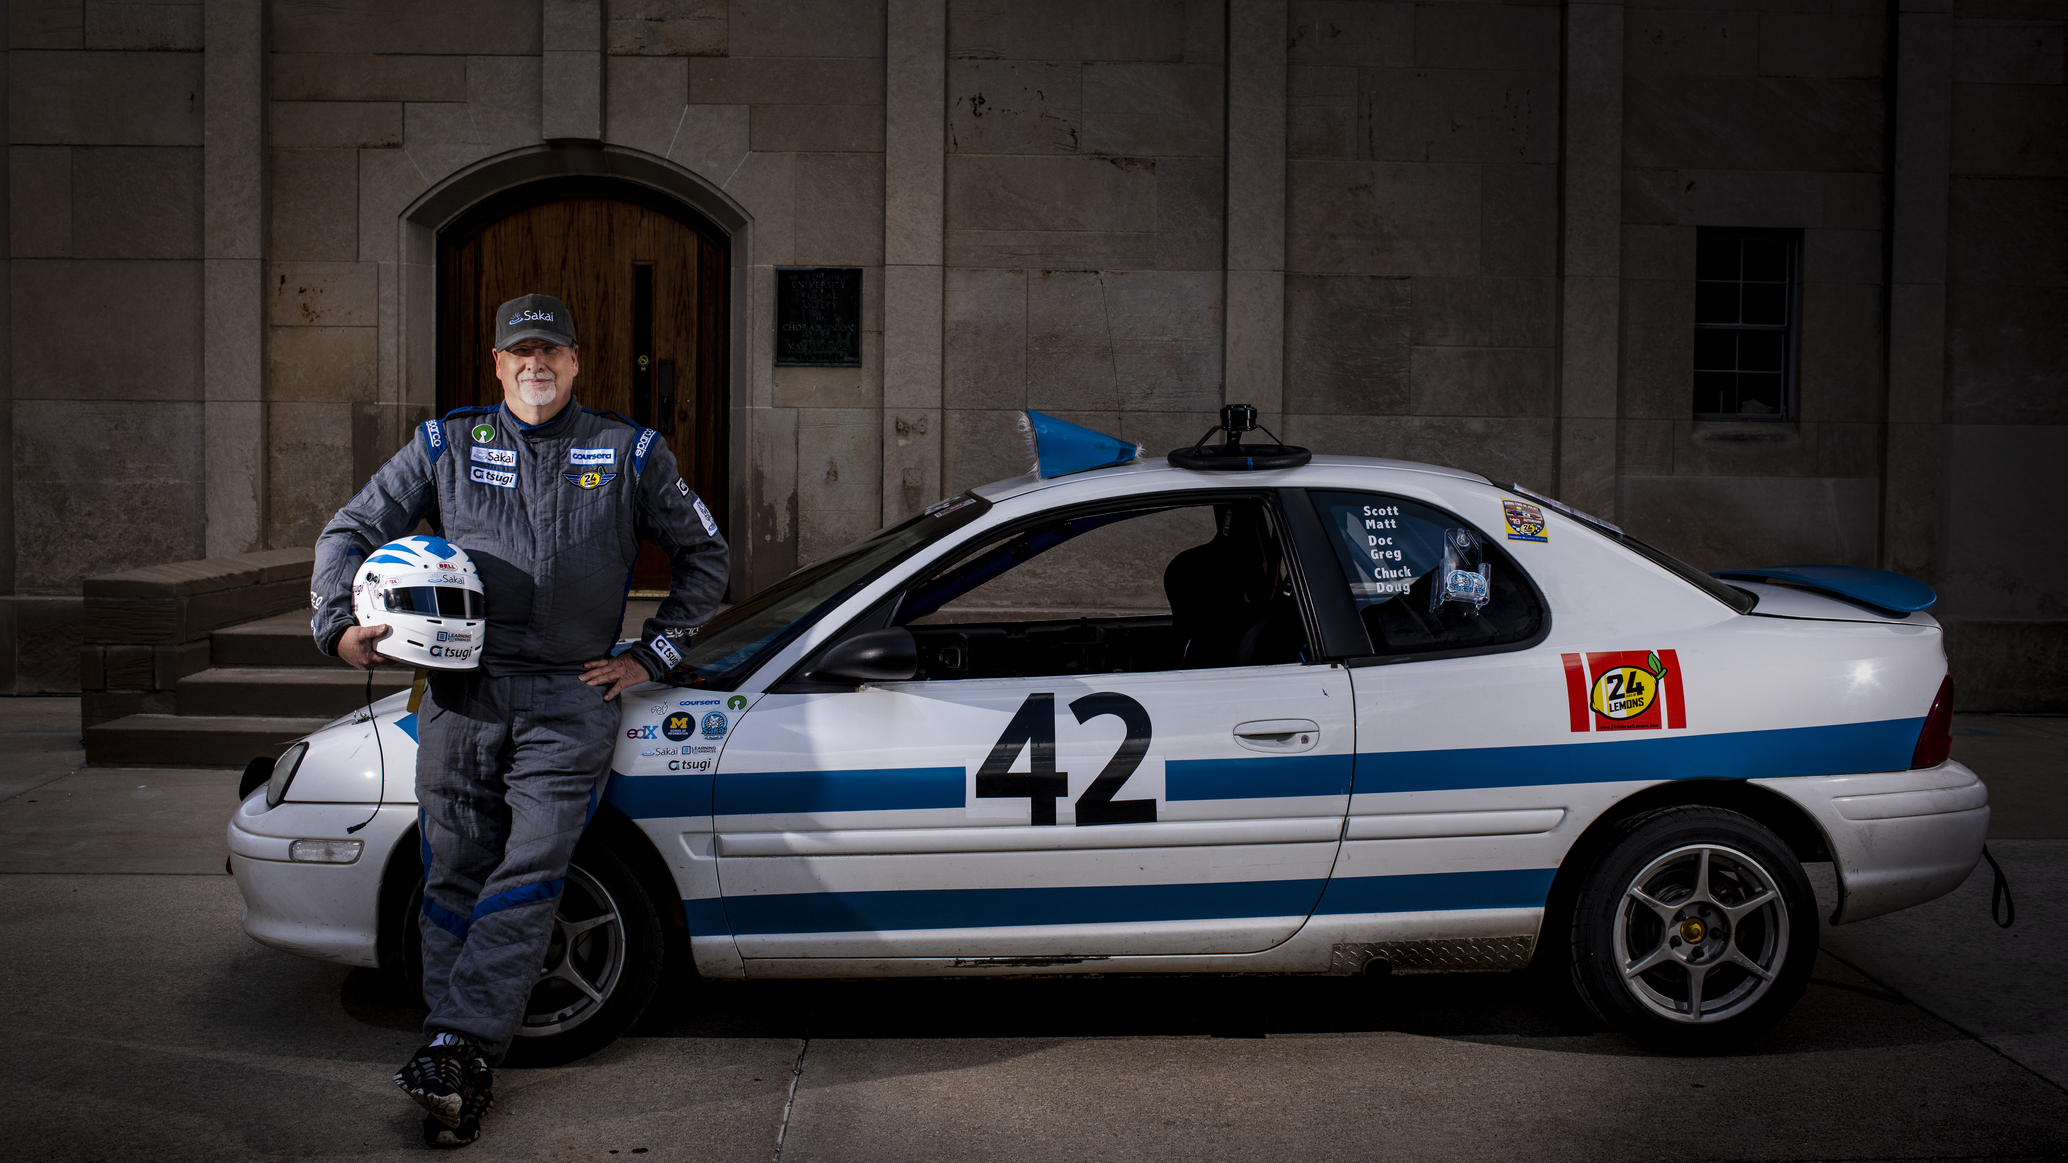
C Programming for Everybody
Charles R. Severance
www.cc4e.com
Photo: Jeffrey Smith

